Slide 1

Development of YSZ – Alloy 718 Functional Graded Material using Laser Directed Energy Deposition
Dilipkumar Choudary Ratnala*, Fabian Hanning, Shrikant Joshi, Joel Andersson
Dilipkumar Ratnala
Department of Engineering Science,
University West – Trollhättan, Sweden
Notes:
Enter speaker notes here.

Slide 2
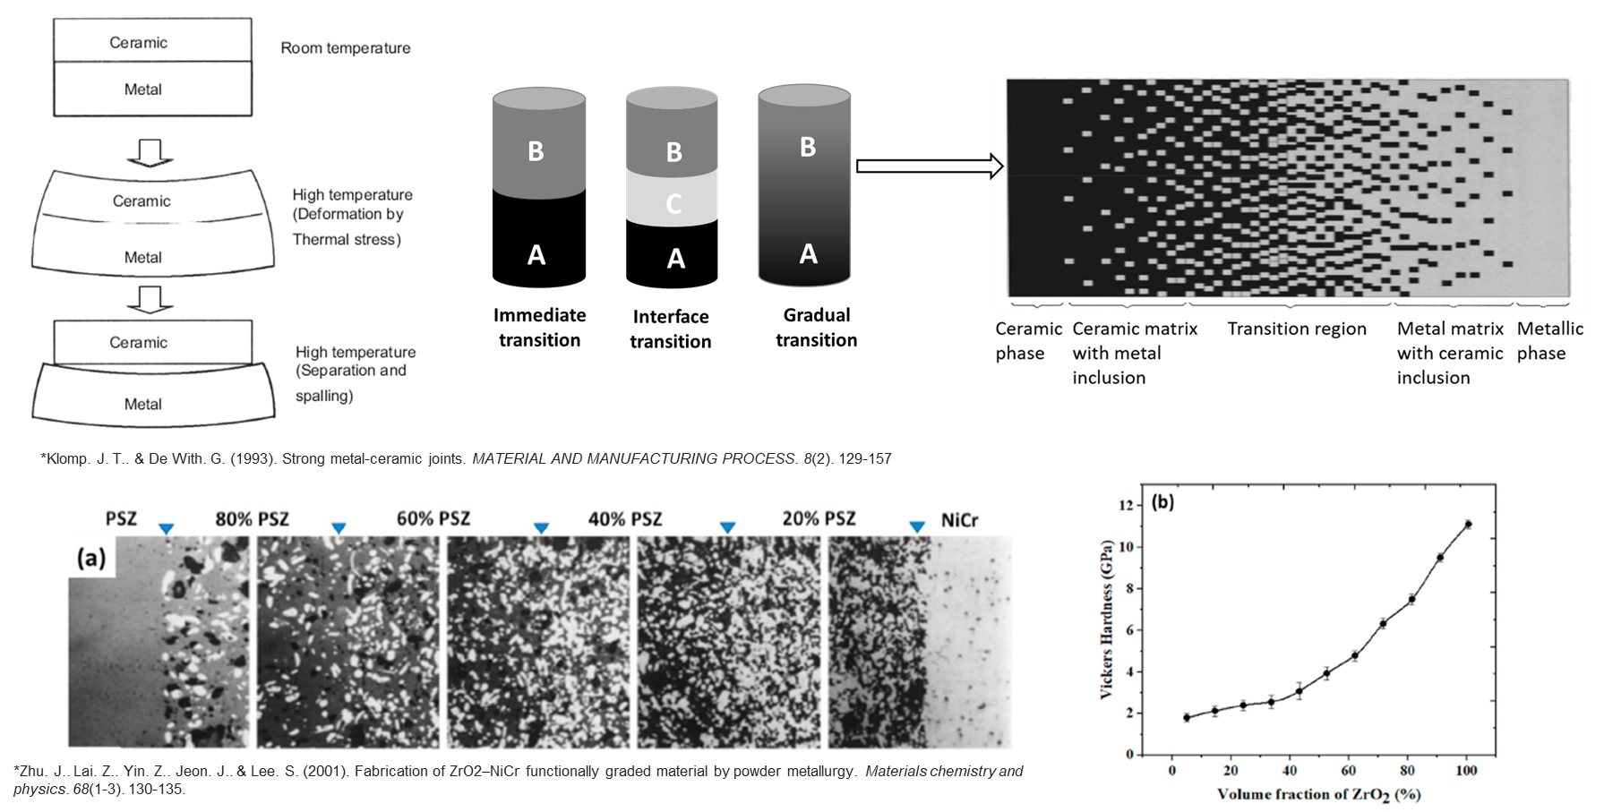
Introduction : Functional Graded Materials
Notes:
Enter speaker notes here.

Slide 3
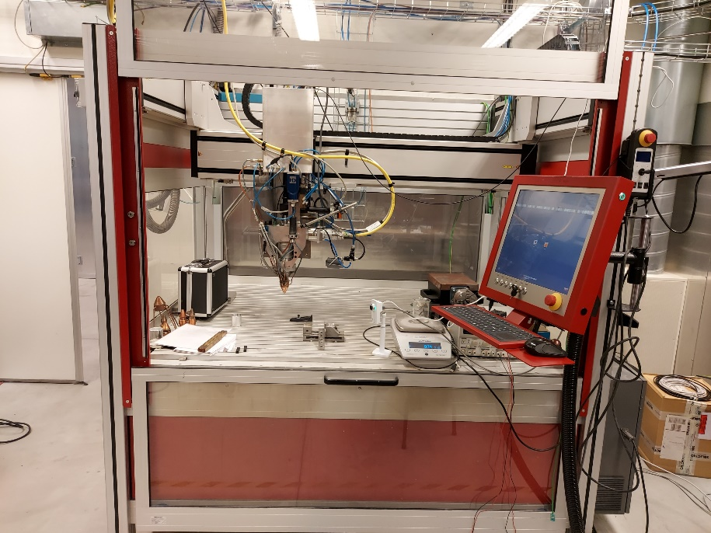
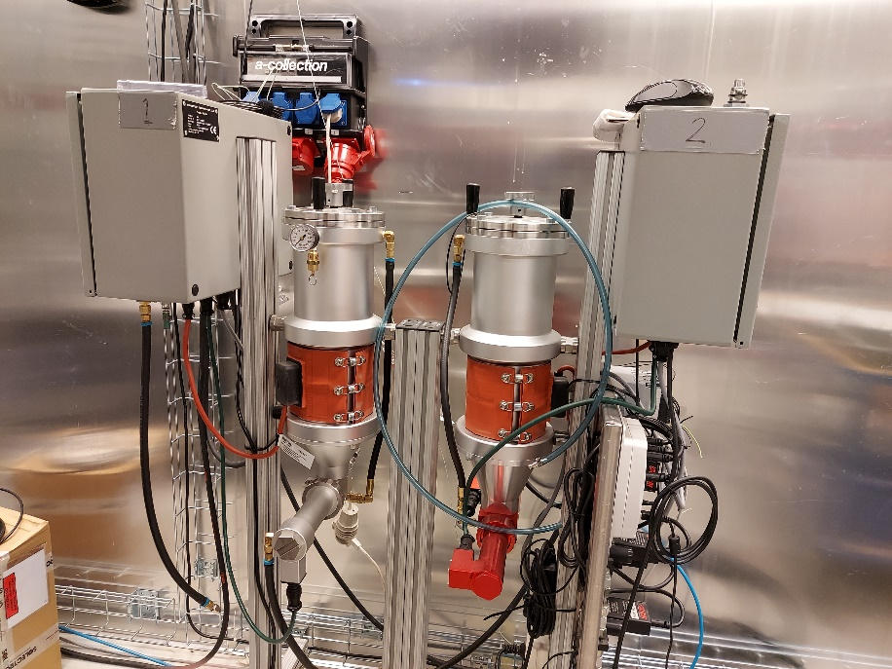
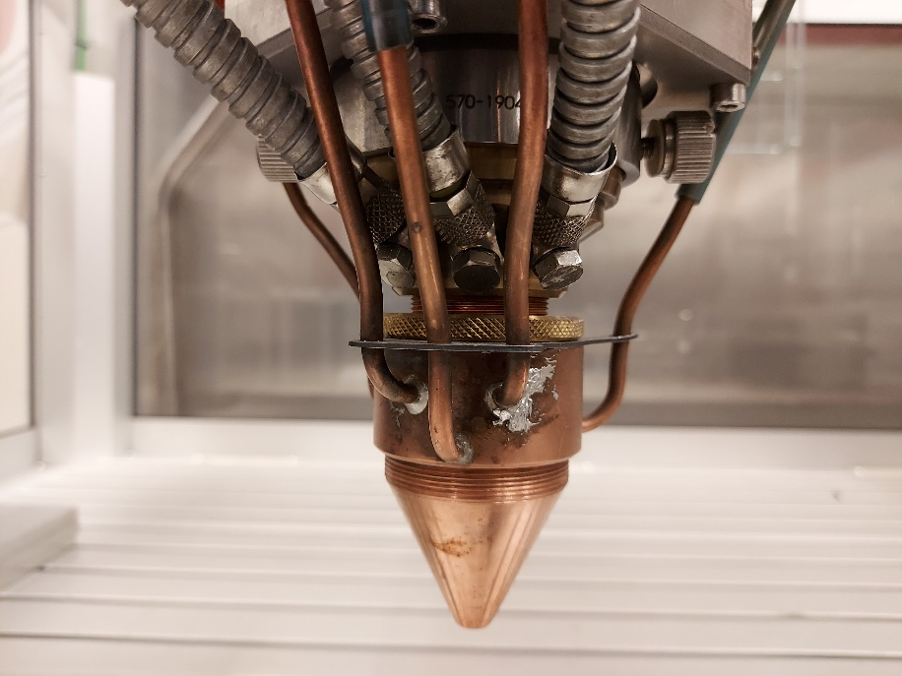
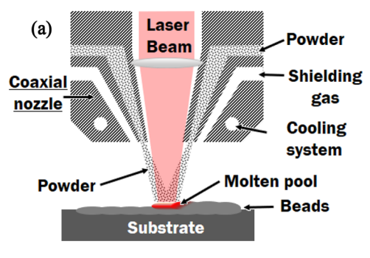
Directed Energy Deposition Process
Twin powder feeder
Directed Energy Deposition system with Laser beam (DED-LB)
Nozzle and its cross section view
Notes:
Enter speaker notes here.

Slide 4
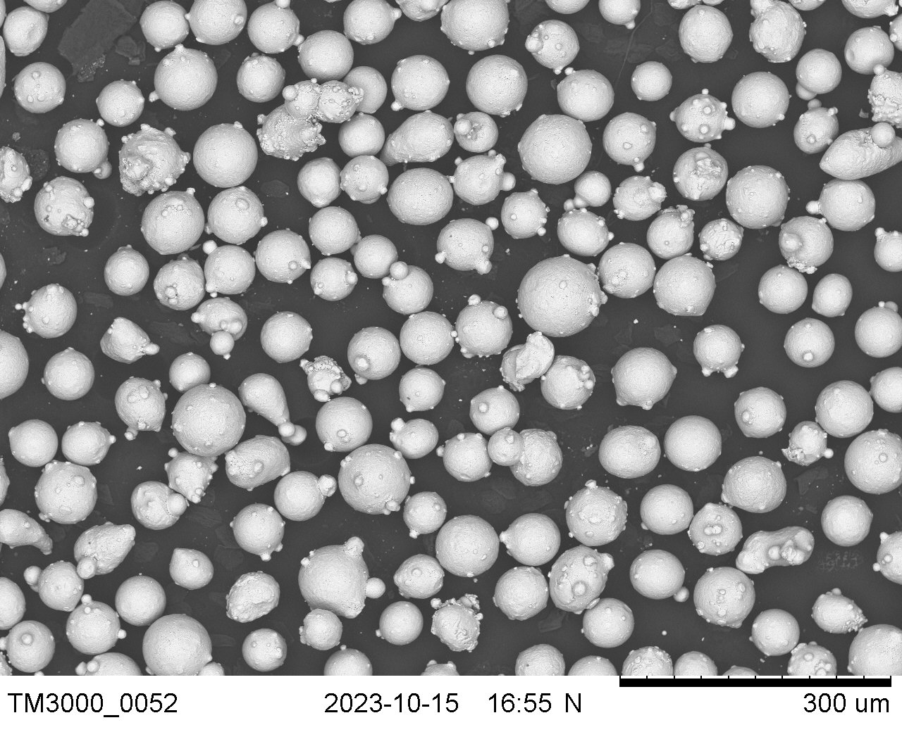
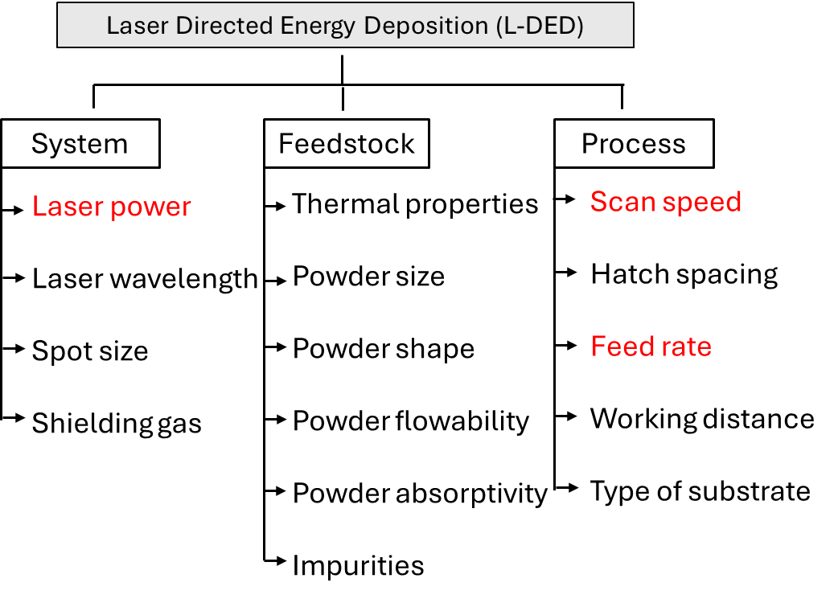
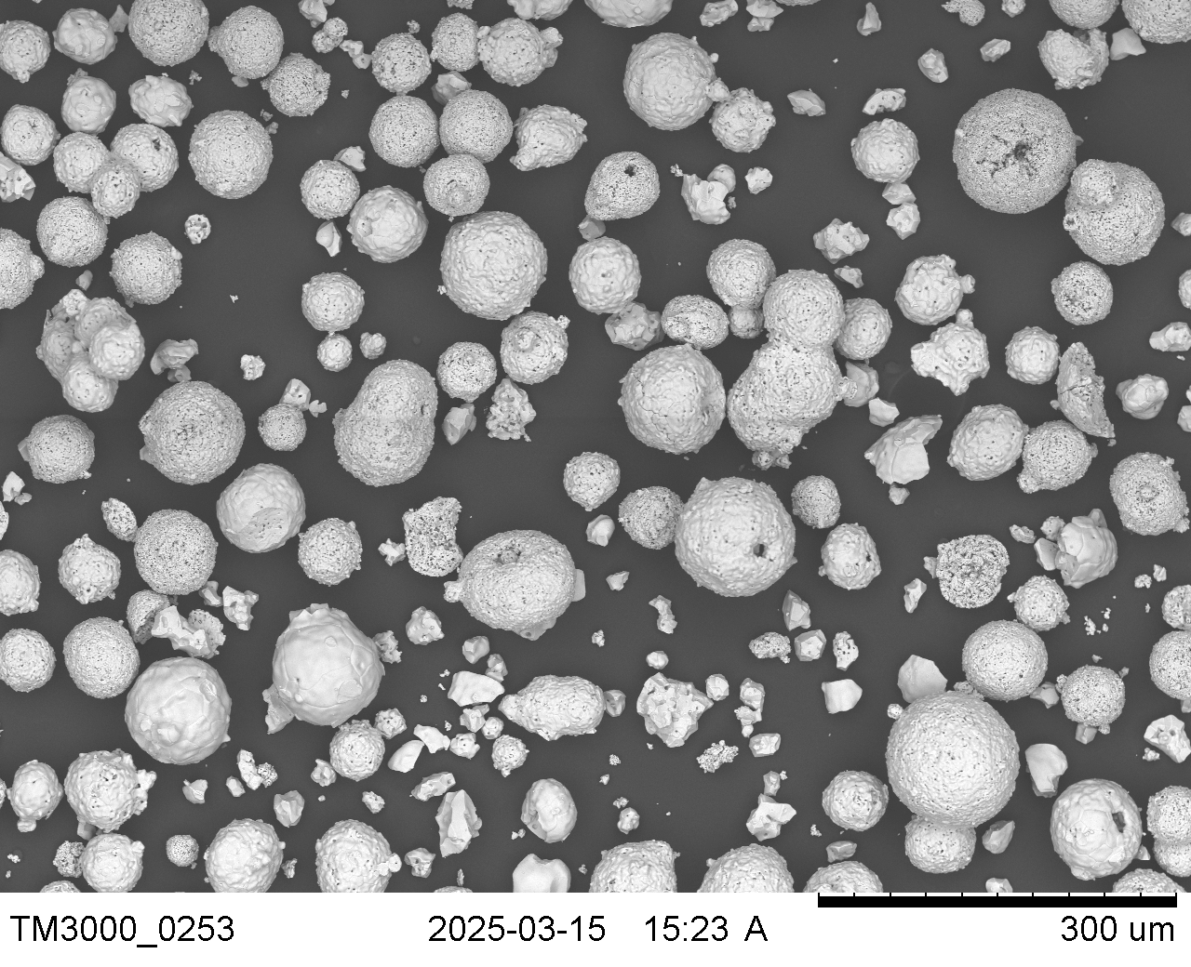
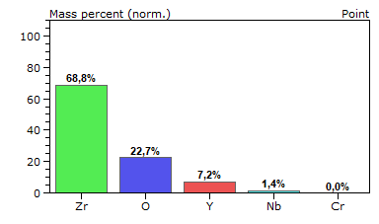
Materials and Method:
Alloy 718
YSZ
Notes:
Enter speaker notes here.

Slide 5
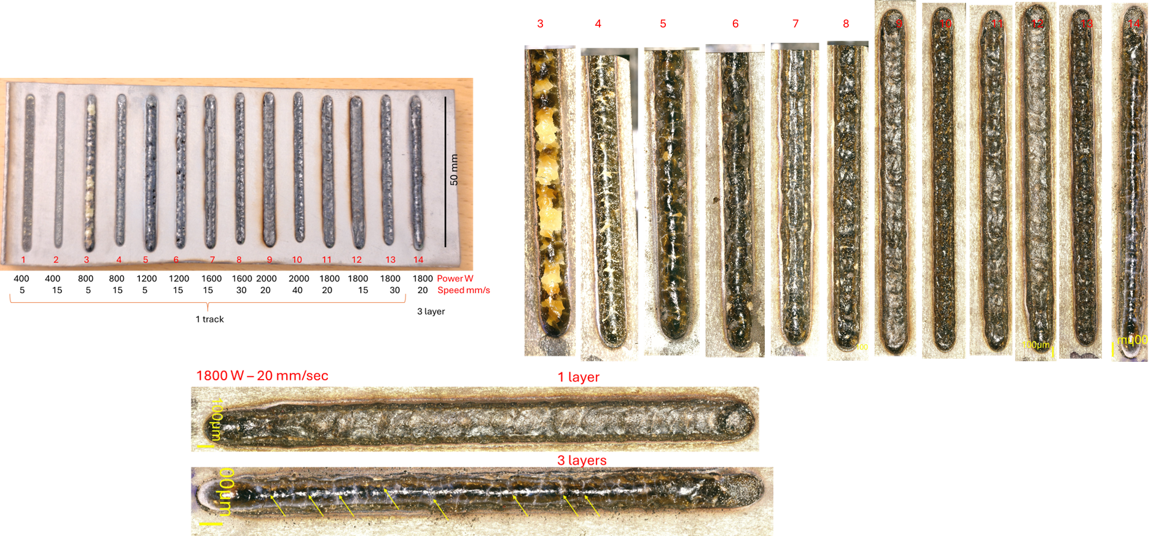
Effect of process parameters :
Single track depositions
Powder feed rate : 10 g/min
Power and Speed : Variable
Presence of surface cracks
Notes:
Enter speaker notes here.

Slide 6
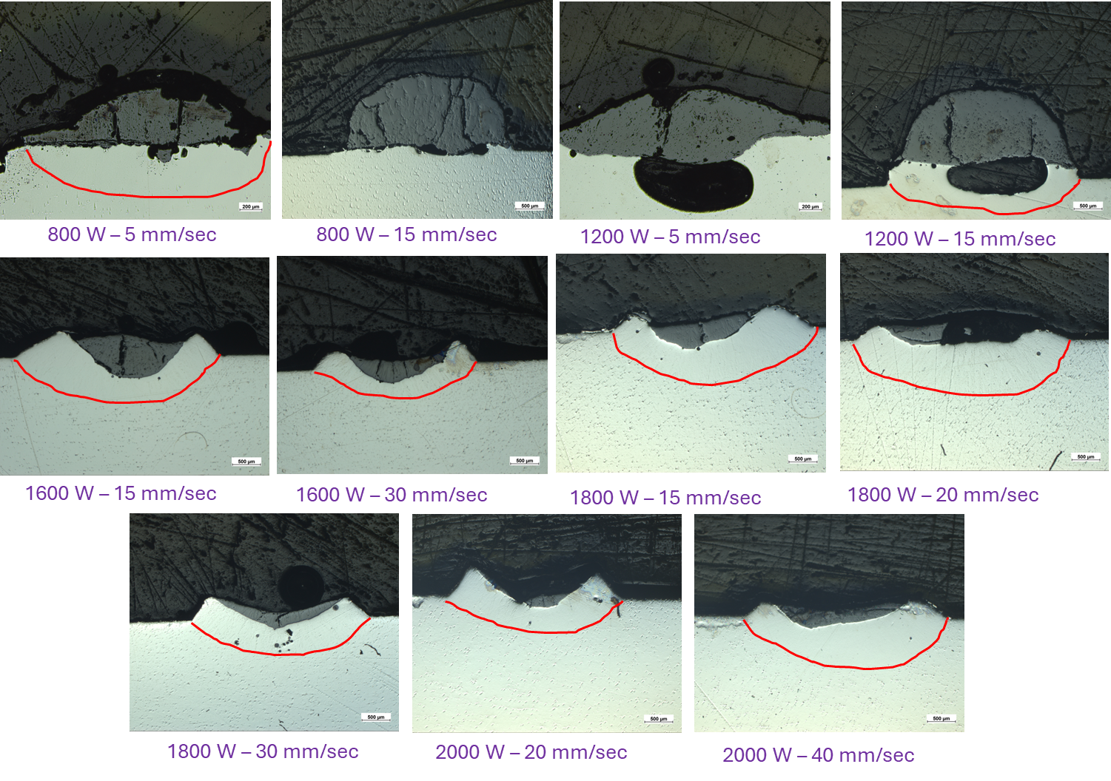
Effect of process parameters : Bead Geometry
No intermixing is observed
Notes:
Enter speaker notes here.

Slide 7
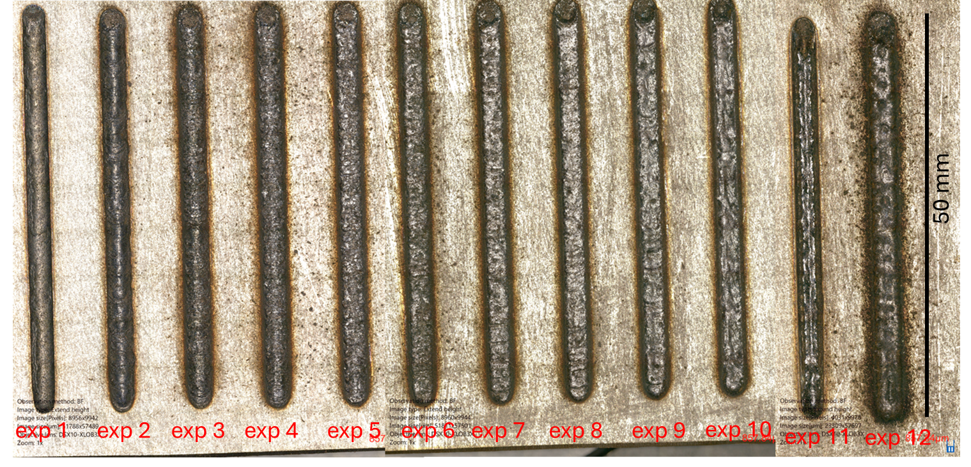
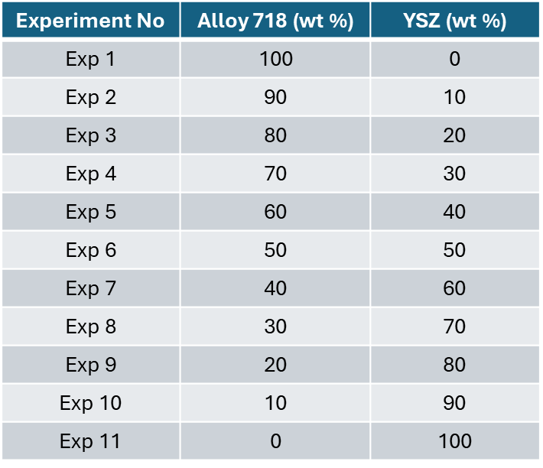
Alloy 718 – YSZ gradient depositions :
Surface morphology of single tracks
Notes:
Enter speaker notes here.

Slide 8
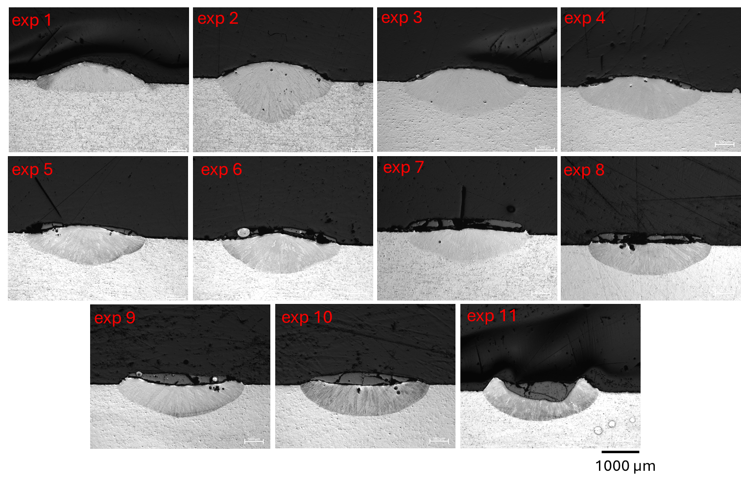
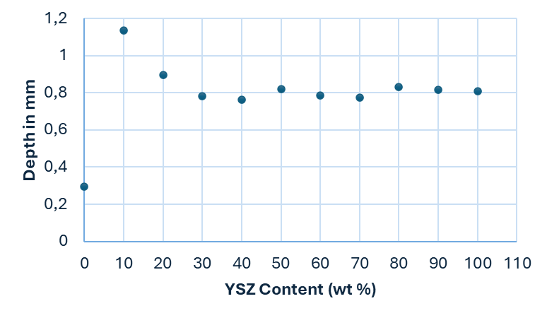
Alloy 718 – YSZ gradient depositions : Cross-section geometry
Notes:
Enter speaker notes here.

Slide 9
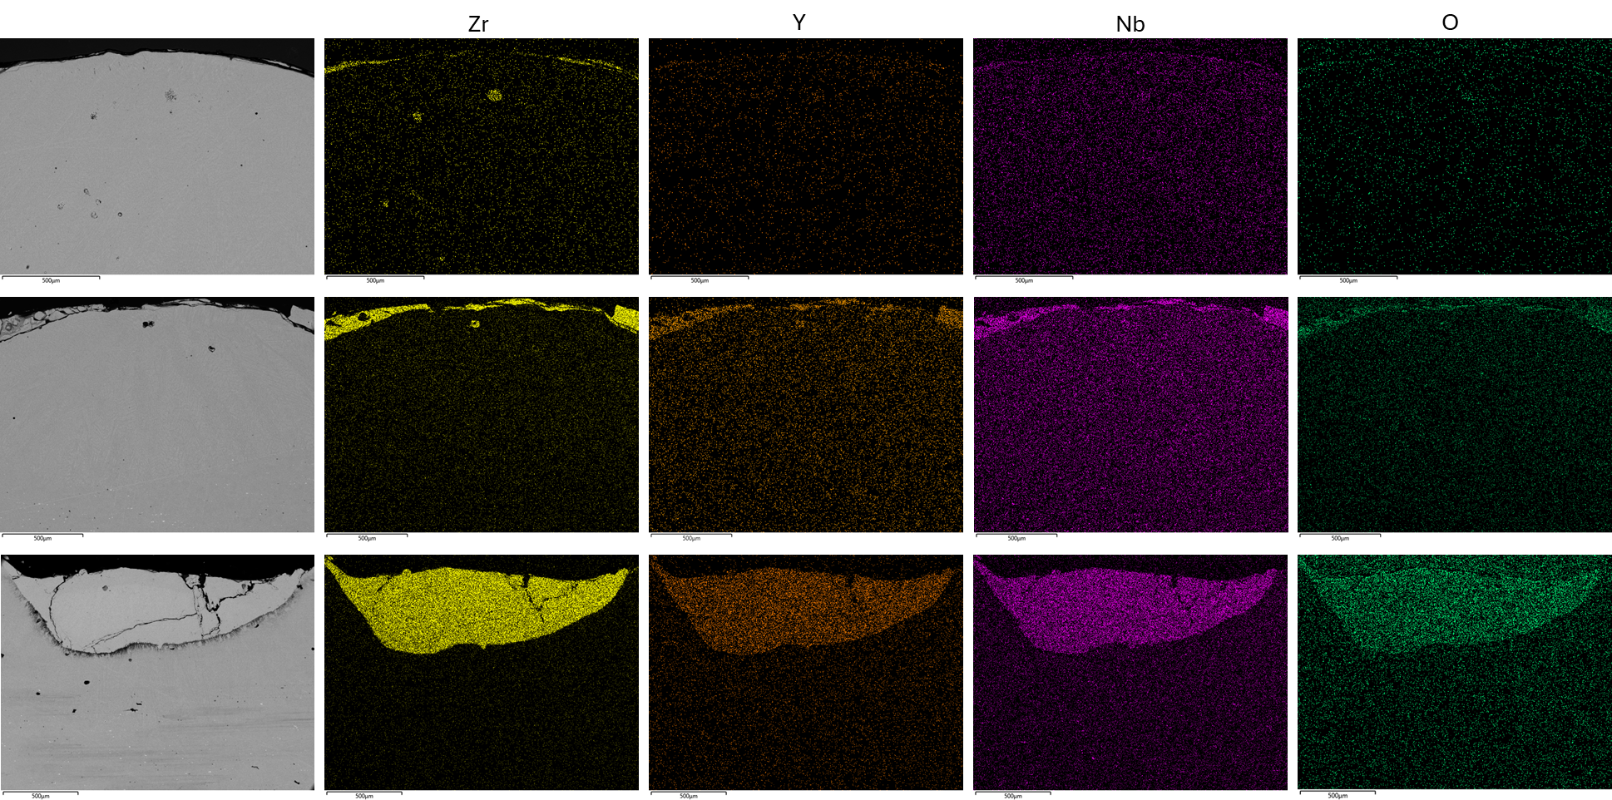
Change in composition with YSZ content:
Exp 2:
10 wt %
Increase in YSZ content (wt %)
Exp 6:
50 wt %
Exp 11:
100 wt %
Notes:
Enter speaker notes here.

Slide 10
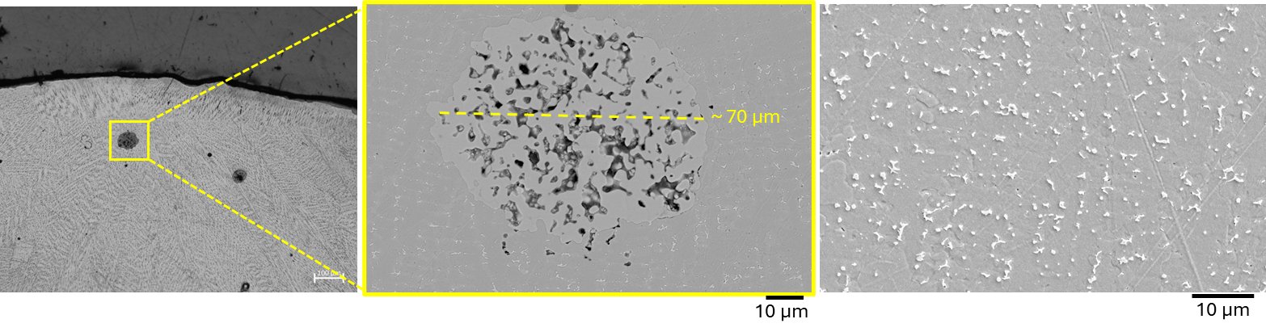
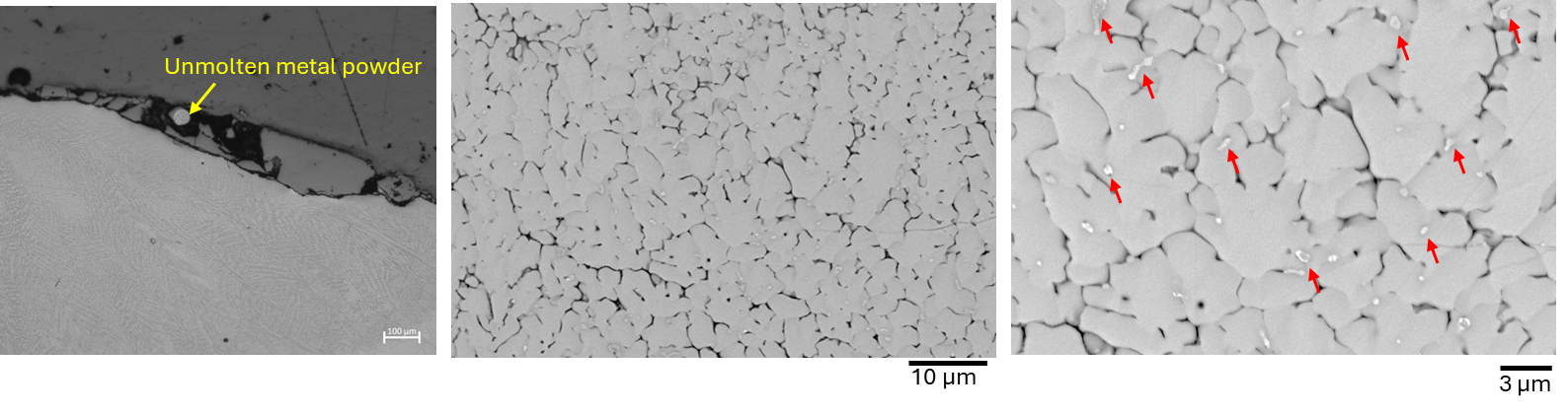
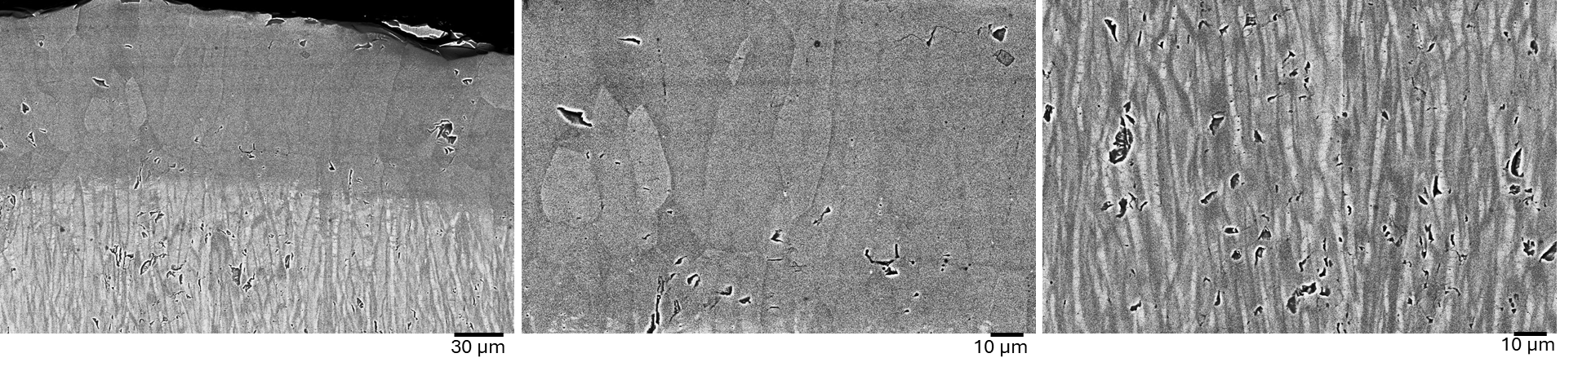
Grain Structure and Phases:
Exp 2 :10 wt % YSZ
Unmolten YSZ powder or segregated YSZ
Exp 6 :50 wt % YSZ
Fine grained structure in ceramic region with bright particles
Exp 11 :100 wt % YSZ
Banded structure
Notes:
Enter speaker notes here.

Slide 11
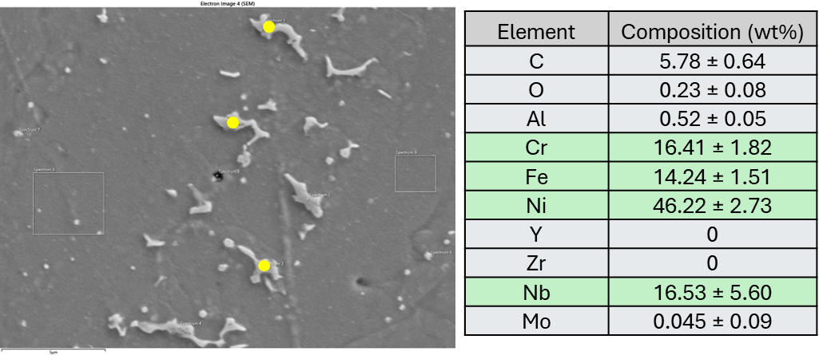
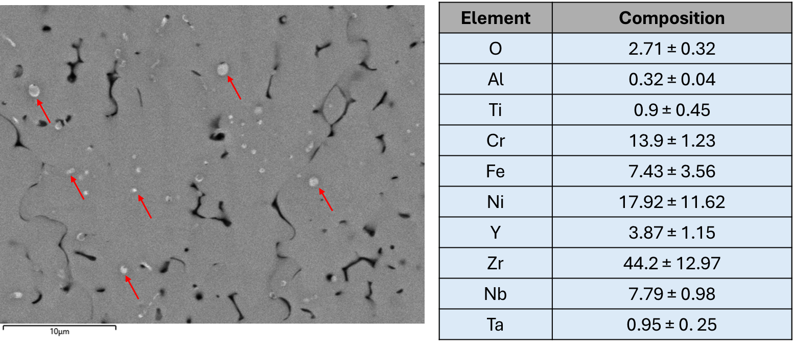
Grain Structure and Phases:
Metal region
Nb rich phases or Laves phases
Ceramic region
Bright spots in the ceramic matrix
Nb, Ni and Cr phases
Notes:
Enter speaker notes here.

Slide 12
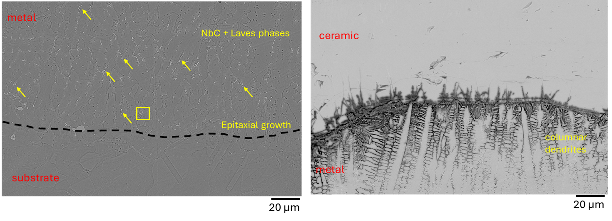
Interface characteristics :
Epitaxial dendritic grain growth from substrate to metal region
Strict grain morphology difference at metal – ceramic boundary
Notes:
Enter speaker notes here.

Slide 13
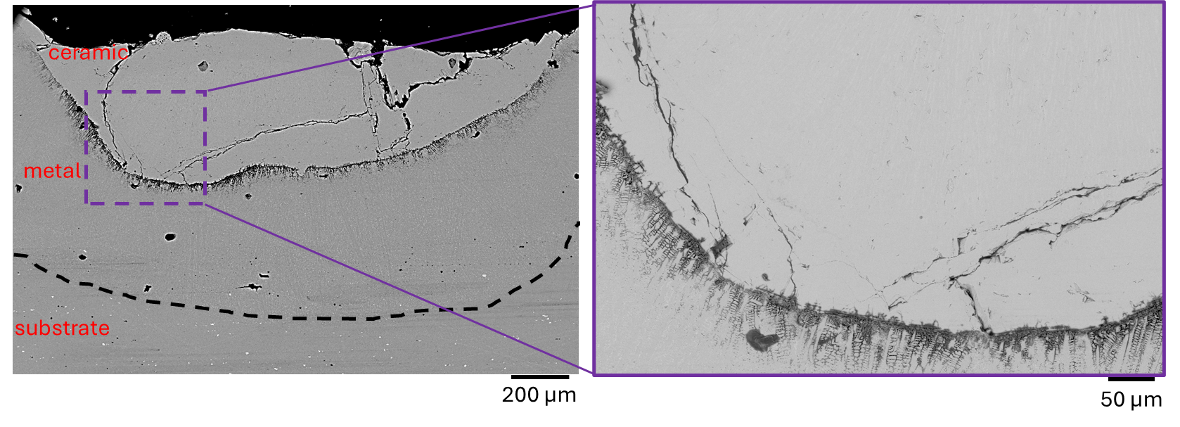
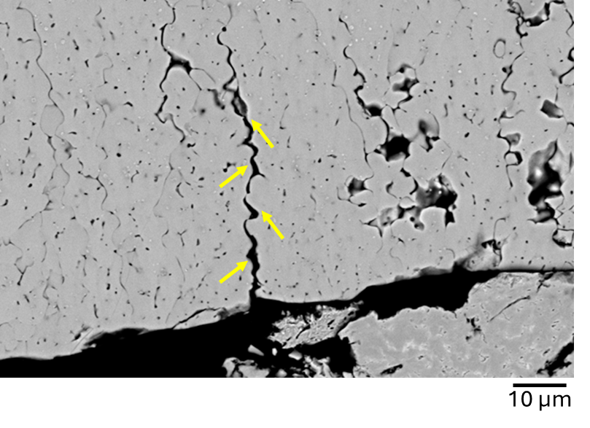
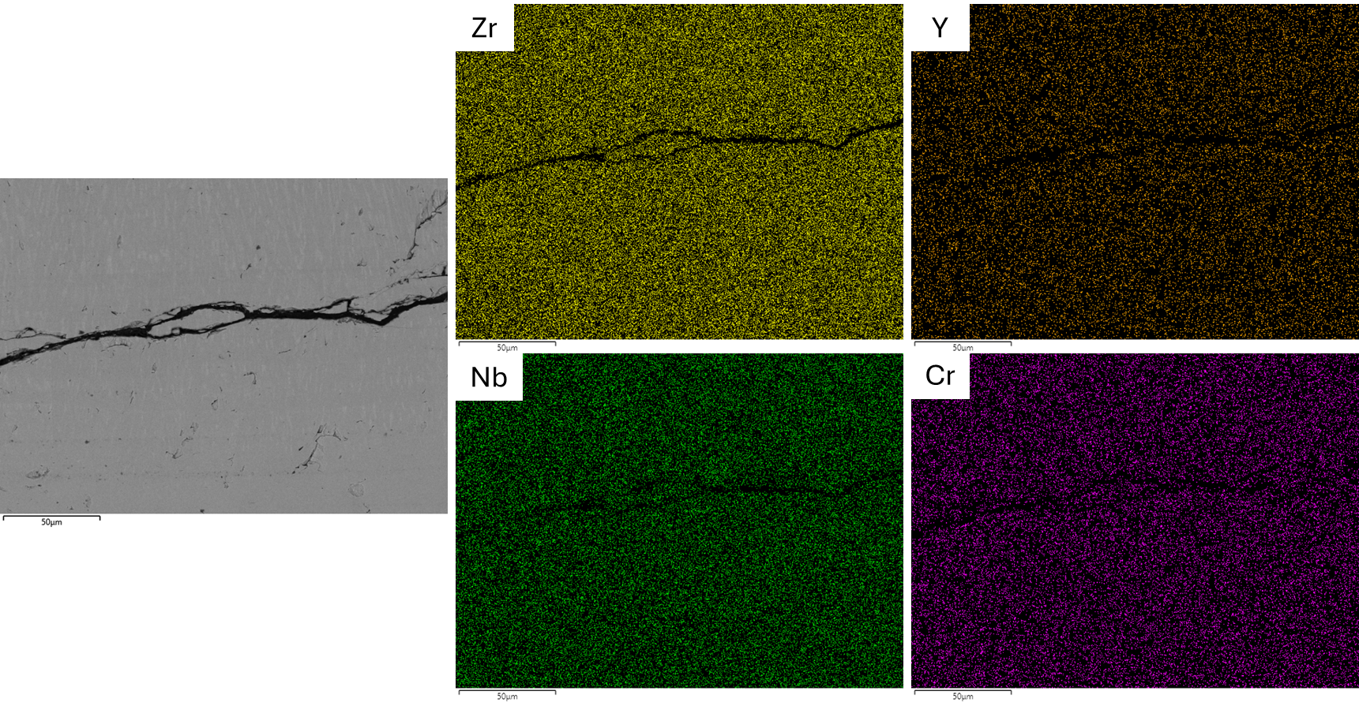
Cracks in ceramic region:
No potential segregation around the cracks
Cracking along the grain boundaries
Notes:
Enter speaker notes here.

Slide 14
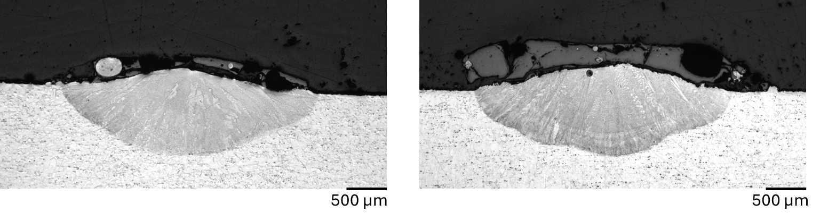
Multiple layer deposition: 3 layers
50 wt% alloy 718 + 50 wt % YSZ
1 layer
3 layers
Ceramic – metal separation for multiple layer deposition as well.
Notes:
Enter speaker notes here.

Slide 15
Conclusions:
The effect of process parameters on deposition of YSZ powder is investigated and observed no intermixing between metallic substrate and ceramic deposition in melt pool.
Unmolten YSZ powder or segregated YSZ regions are found in 10 wt % YSZ + 90 wt % alloy 718 deposition. A clear separation of metal and ceramic regions in gradient tracks of more than 20 wt % YSZ.
Banded structure observed in 100 wt% YSZ region suggests the grain growth opposite to heat dissipation direction.
Presence of bright particles with enrichment of Nb, Ni, Cr and Fe might act as nucleation sites for the graded depositions which led to fine grained morphology.
Sudden change of grain morphology at metal – ceramic boundary, large thermal gradients and different thermal property differences between alloy 718 and YSZ generated thermal stresses, that led to cracking in ceramic region.
Notes:
Enter speaker notes here.

Slide 16
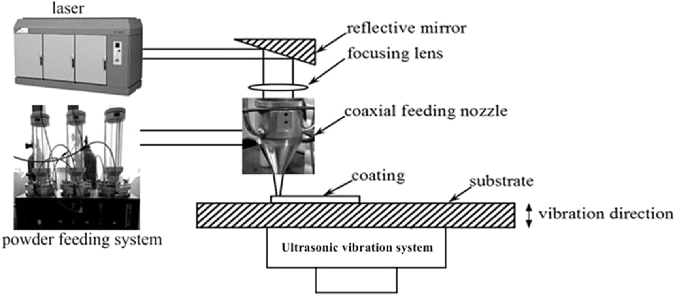
Future work:
EBSD and TEM analysis for better understanding of grain structure and bright particles in ceramic region
Ultrasonic assisted Directed Energy Deposition to improve the mixing in the melt pool during the process.
*Ma, G., Yan, S., Wu, D., Miao, Q., Liu, M., & Niu, F. (2017). Microstructure evolution and mechanical properties of ultrasonic assisted laser clad yttria stabilized zirconia coating. Ceramics International, 43(13), 9622-9629.
Notes:
Enter speaker notes here.

Slide 17


Thank You for Your Attention
Notes:
Enter speaker notes here.

